Slide 1

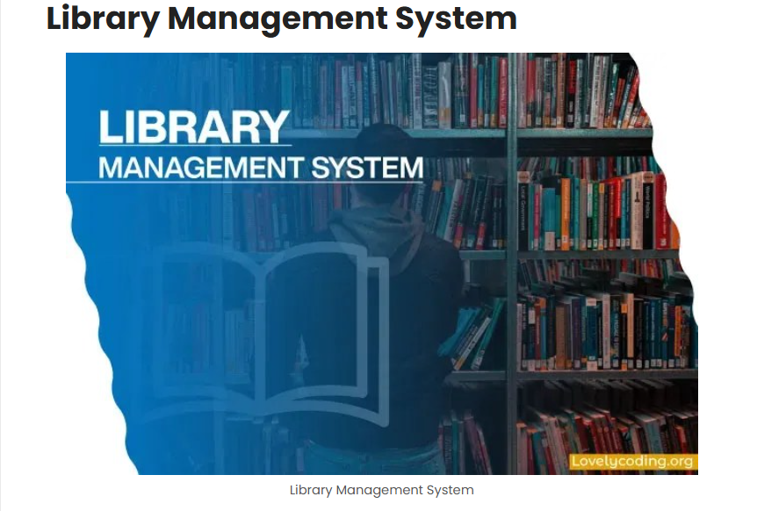

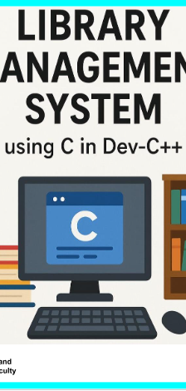
LIBRARY MANAGEMENT SYSTEM
Using C in Dev-C++

Slide 2

Written By
Name: Pasang Chand
Roll Number: 126
Class: 12(XII)
Subject: Computer
Faculty: Science

Slide 3
Library Management System
A Library Management System is software used to manage library activities efficiently.
It helps in organizing, recording, and tracking books and members.
The system automates tasks like issuing, returning, and cataloging of books.
It reduces manual work, errors, and paperwork in library management.
The system makes library services faster, easier, and more accurate for both librarians and users.

Slide 4
File Handling
Process of working with files in a computer program.
It allows programs to store and retrieve data for later use.
Basis Steps involved in file handling
Opening a file
Reading data from a file
Writing data to a file
Closing a file
Is efficient, flexible, and reliable.

Slide 5
Pointer
A variable that stores the memory address of another variable.
It points to other variable by holding its address.
Program execution time will be faster.
When declaring a pointer variable, the asterisk (*) is used.

Slide 6
Advantages of Library Management System:
Saves Time: Automates book issue, return, and cataloging processes.
Increases Accuracy: Minimizes human errors in record keeping.
Easy Access: Provides quick access to books and member information.
Efficient Management: Simplifies tracking of books and users.
User-Friendly: Makes library services faster and more convenient for everyone.
1

Slide 7
Disadvantages of LIBRARY MANAGEMENT SYSTEM:
High Initial Cost: Setting up the system and software can be expensive.
Technical Issues: System errors or crashes can interrupt library operations.
Training Requirement: Librarians and users need training to use the system properly.
Data Security Risks: If not protected, data can be lost or hacked.
Dependence on Technology: The library cannot function smoothly without computers or internet access.

Slide 8
Objectives of Library Management System
To automate library operations such as book issue, return, and catalog management.
To maintain accurate records of books, members, and transactions.
To save time and effort for both librarians and users.
To provide easy and quick access to library resources and information.
To improve efficiency and organization in overall library management.

Slide 9
Features available to the Administrator are:
User Management
Book Management
Issue/Return Management
Reports and Logs
System Access Control

Slide 10
Features available to the Users are:
Account Management
Book Access
Book Transactions
Records Access

Slide 11
Limitations:
File-Based Storage
Single-User Operation
Limited Security
Manual Data Validation
No Advanced Reporting

Slide 12
C programming language:
C is a general-purpose, structured, and simple language that provides faster execution.
C is known for its simplicity, efficiency, and flexibility.
C allows writing efficient, fast, and portable programs.
C provides direct access to memory addresses through pointers.
C is widely used in system programming, embedded systems, and developing operating systems.

Slide 13
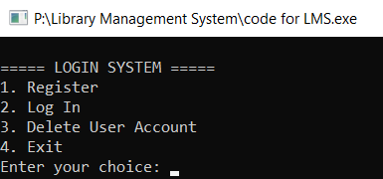
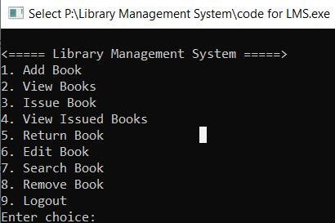
Login Form
Menu

Slide 14
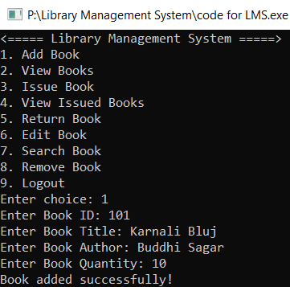
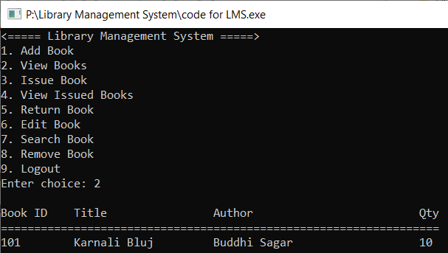
Add And View Book

Slide 15
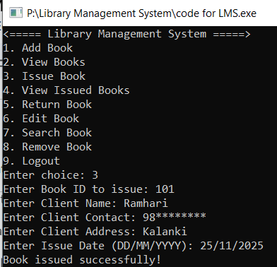
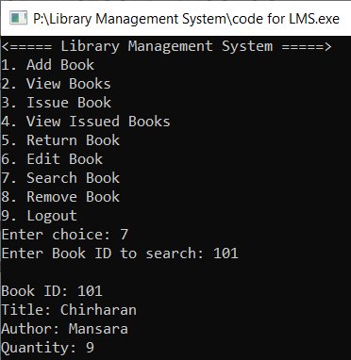

Issue And Search Book
Balsamiq Tip | Information architecture is the flow of content across the site or application (more info).

Slide 16
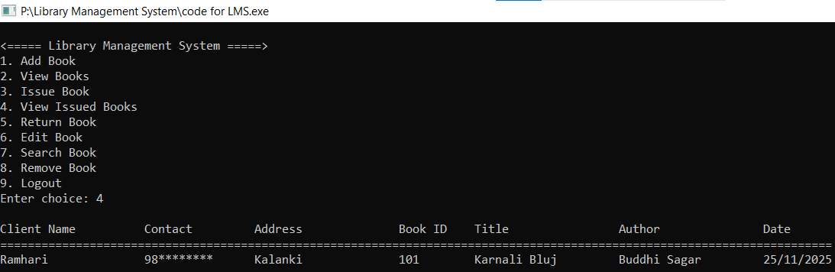
View Issue Book
Balsamiq Tip | Use the Balsamiq add-on to make your own wireframe.

Slide 17
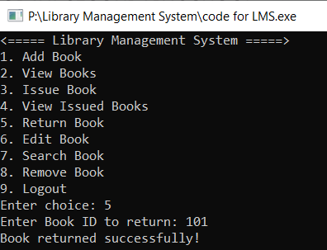
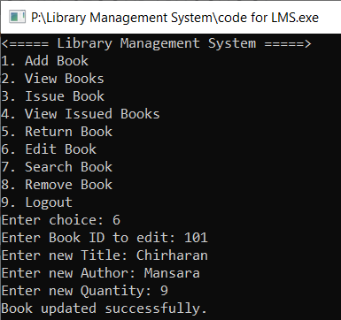
Return And Edit Book

Slide 18
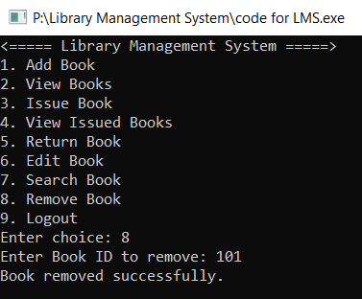
Remove Book

Slide 19
Conclusion:
The Library Management System (LMS) is an efficient and organized way to manage books, users, and transactions in a library. It simplifies tasks like adding, issuing, returning, and tracking books, reducing manual effort and errors. LMS improves accessibility, saves time, and ensures smooth management of library resources, making it an essential tool for modern libraries.

Slide 20


Slide 21
Bibliography
https://www.w3schools.com/c/c_break_continue.php
https://www.tutorialspoint.com/ansi_c/c_working_with_files.htm#:~:text=For%20C%20File%20I%2FO,which%20returns%20a%20FILE%20pointer
https://www.javatpoint.com/file-handling-in-c
https://www.programiz.com/c-programming
https://youtu.be/irqbmMNs2Bo?si=Gx02GbyEsame4Scq (ApnaCollege)
https://youtu.be/VSEnzzjAm0c?si=YZnJQp3WjoqS0H8n(Learn Coding)
https://youtu.be/87SH2Cn0s9A?si=asSBo0BXzIzU04IP(Bro Code)

Slide 22


